Slide 1

ImageMedix
By Team 5 The Minions
Sprint 3

Slide 2
Agenda
Team Roles & Responsibilities
Improvements from Professor Feedback
Project Description
Team Working Agreement
Personas
MVP
Technologies and Algorithms
Diagrams
Product Backlog
Sprint 3 Backlog
Metrics
Retrospective
Sprint 3 Demo
GitHub Repository
Live Application Demo
Sprint 2 Recap

Slide 3
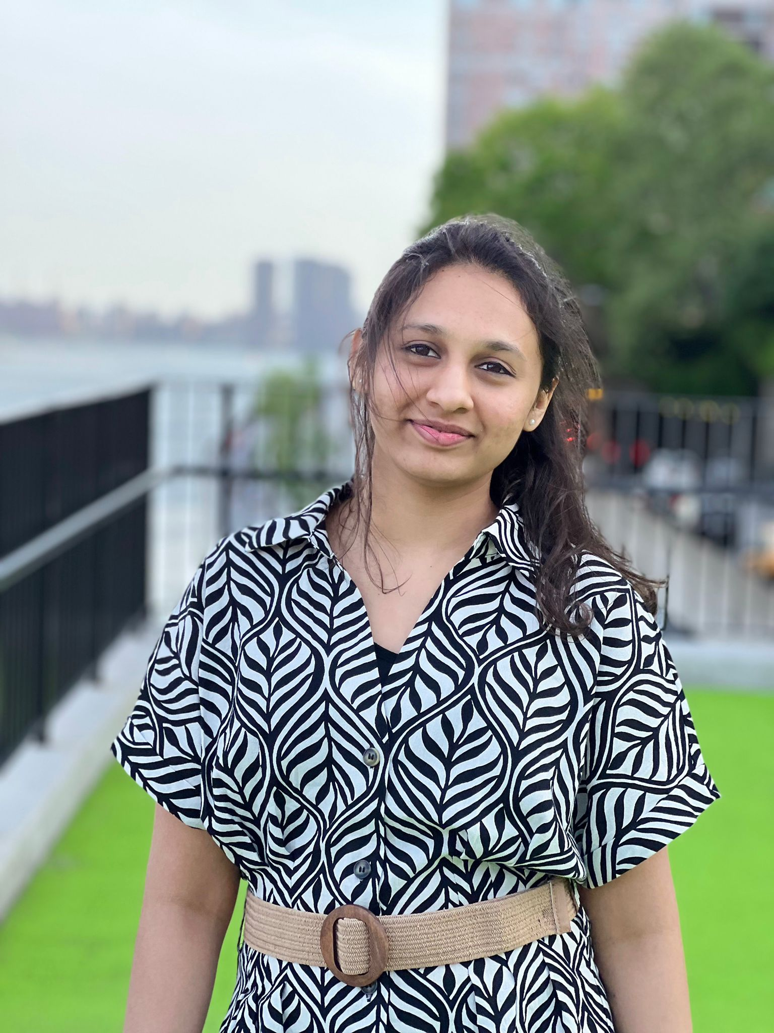
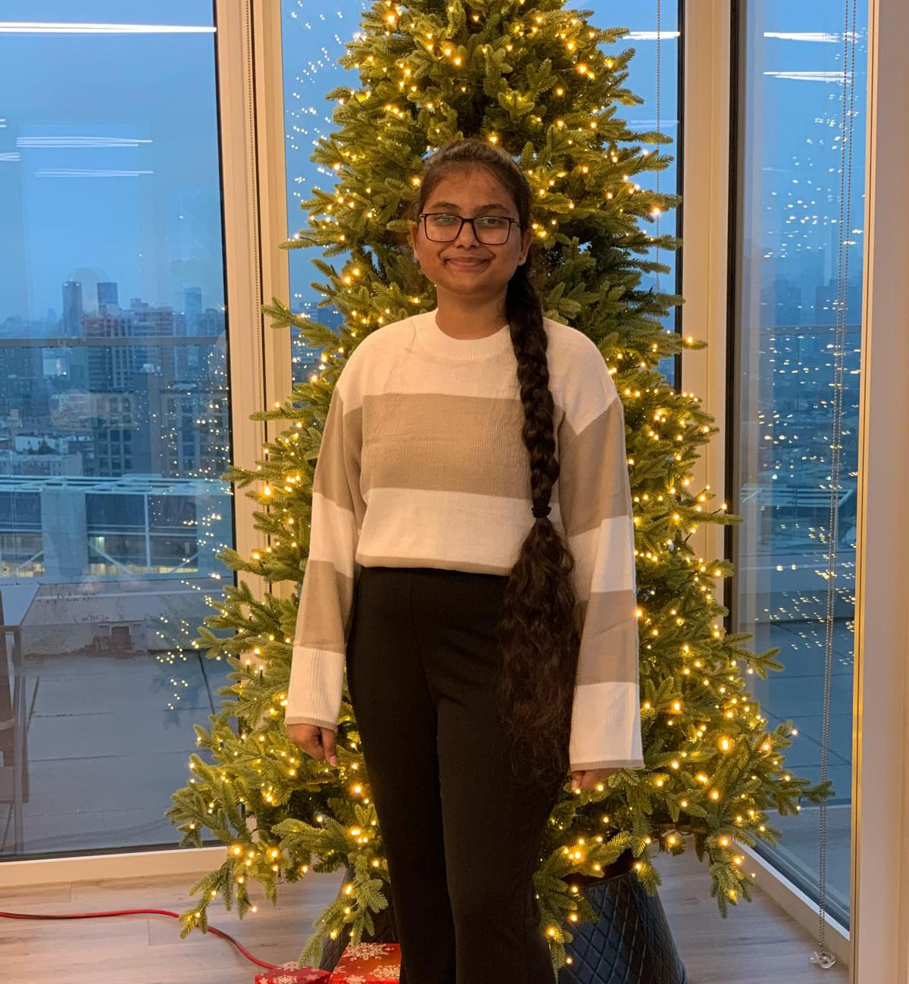

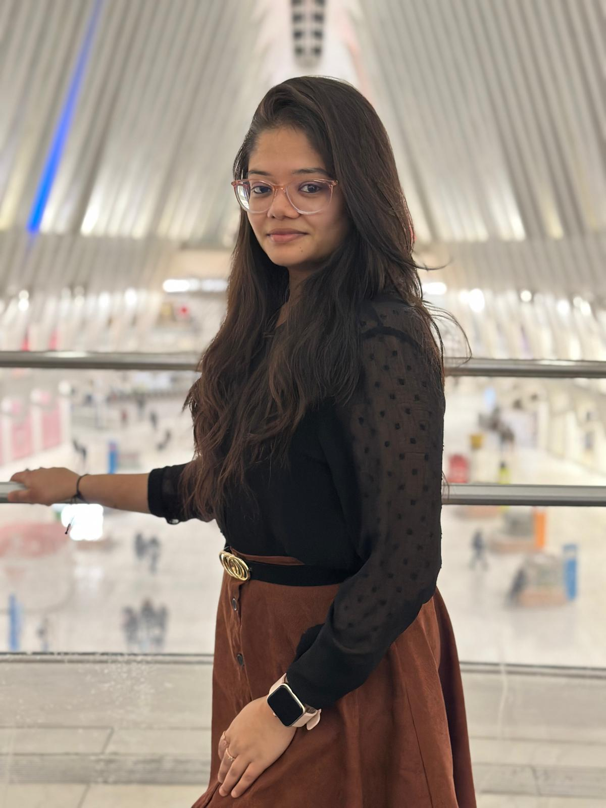
Team Members – machine learning
Vaishnavi Chandrasekar
Christiana Heden Kothuru
Deepika Mothkuri
Greeshma Kenche

Slide 4
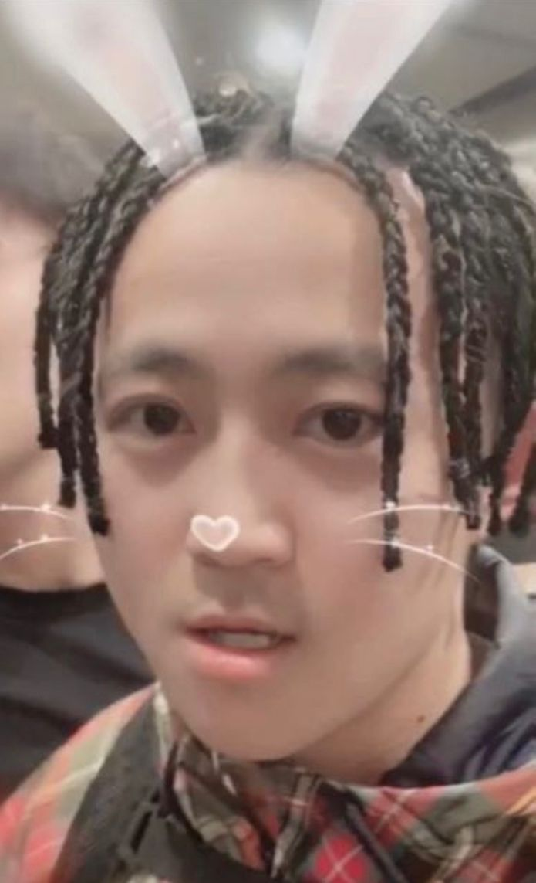
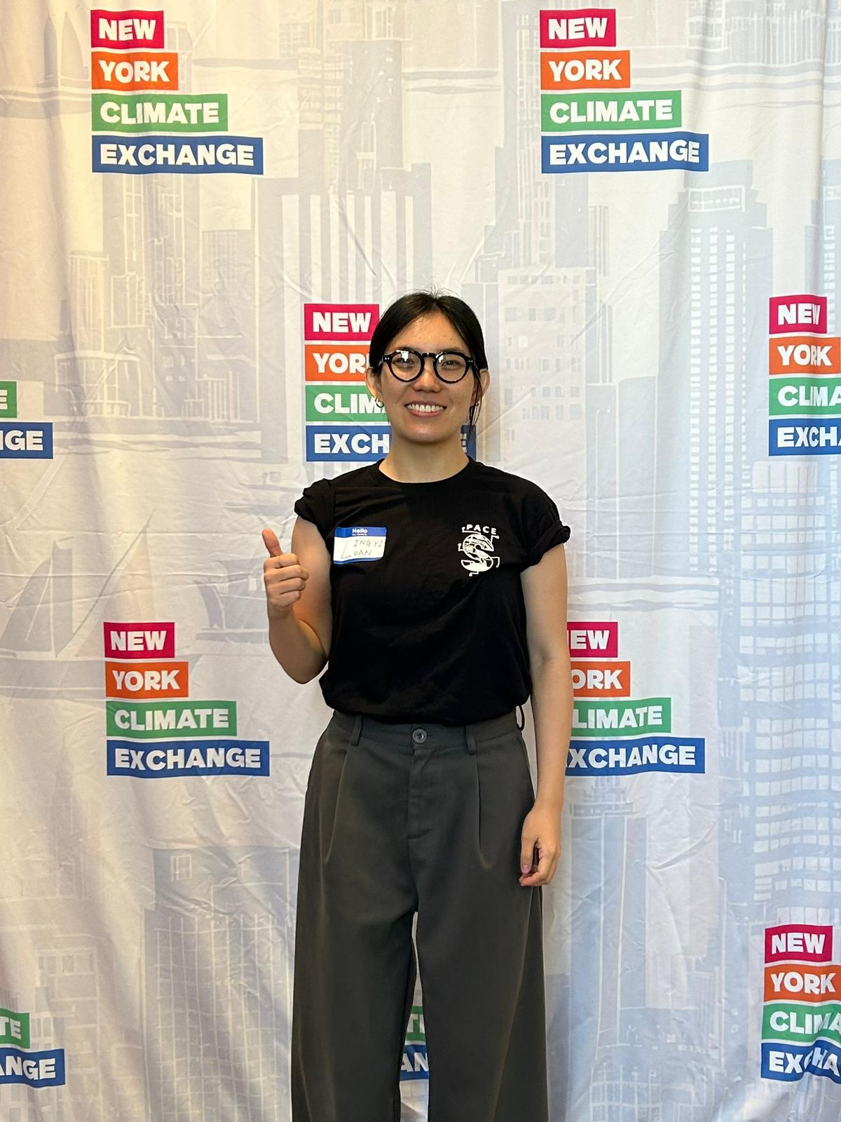
Team Members – Backend
Yucong Hu
Lingyi Luan

Slide 5

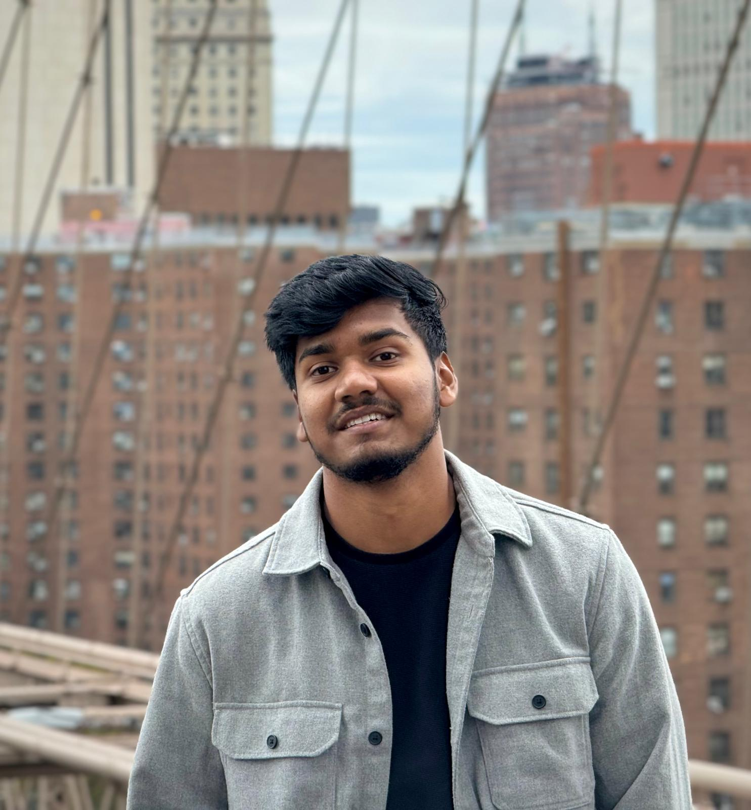
Team Members – Frontend
Yash Bhanubhai Panchani
Rameez Ahmed Shaik

Slide 6

Improvements
Conduct proper sprint planning before starting the sprint.
Submit the burndown chart in the correct format on the wiki page.
Add a recap summary of the previous sprint in the presentation.
Correct wording issues in user stories (e.g., "Appealing landing" in US-01).
Add an average line to the team velocity chart.
Include API slides in the sprint presentation.
Add every improvement point mentioned in the professor's feedback to the next sprint PPT slides.

Slide 7
Problem statement
Many healthcare facilities face challenges in diagnosing pneumonia and brain tumors quickly and accurately, often due to limited access to specialists and high workloads. Current solutions typically require separate systems to analyze different types of medical images. This leads to inefficiencies in diagnosis and delays in providing critical care. There is a need for an automated system that can efficiently classify medical images and provide preliminary diagnoses to support healthcare professionals in making timely decisions.

Slide 8
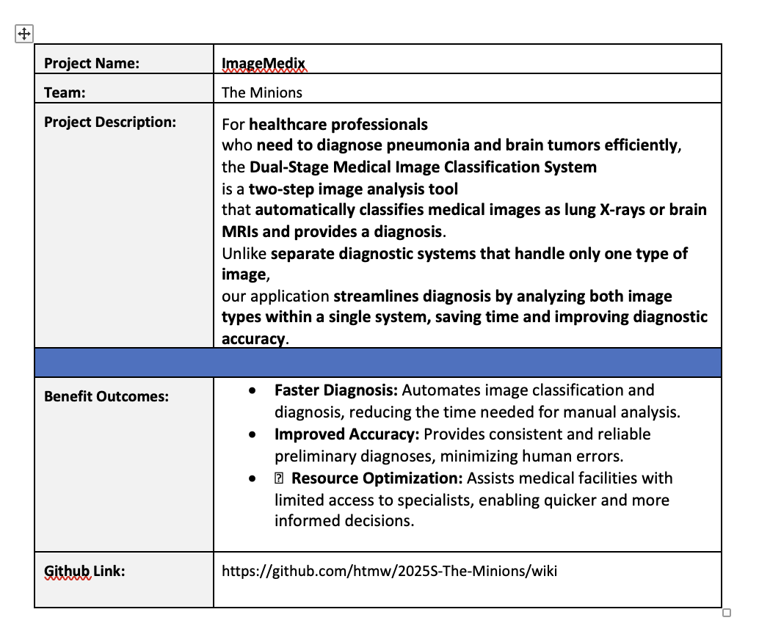
Project description

Slide 9
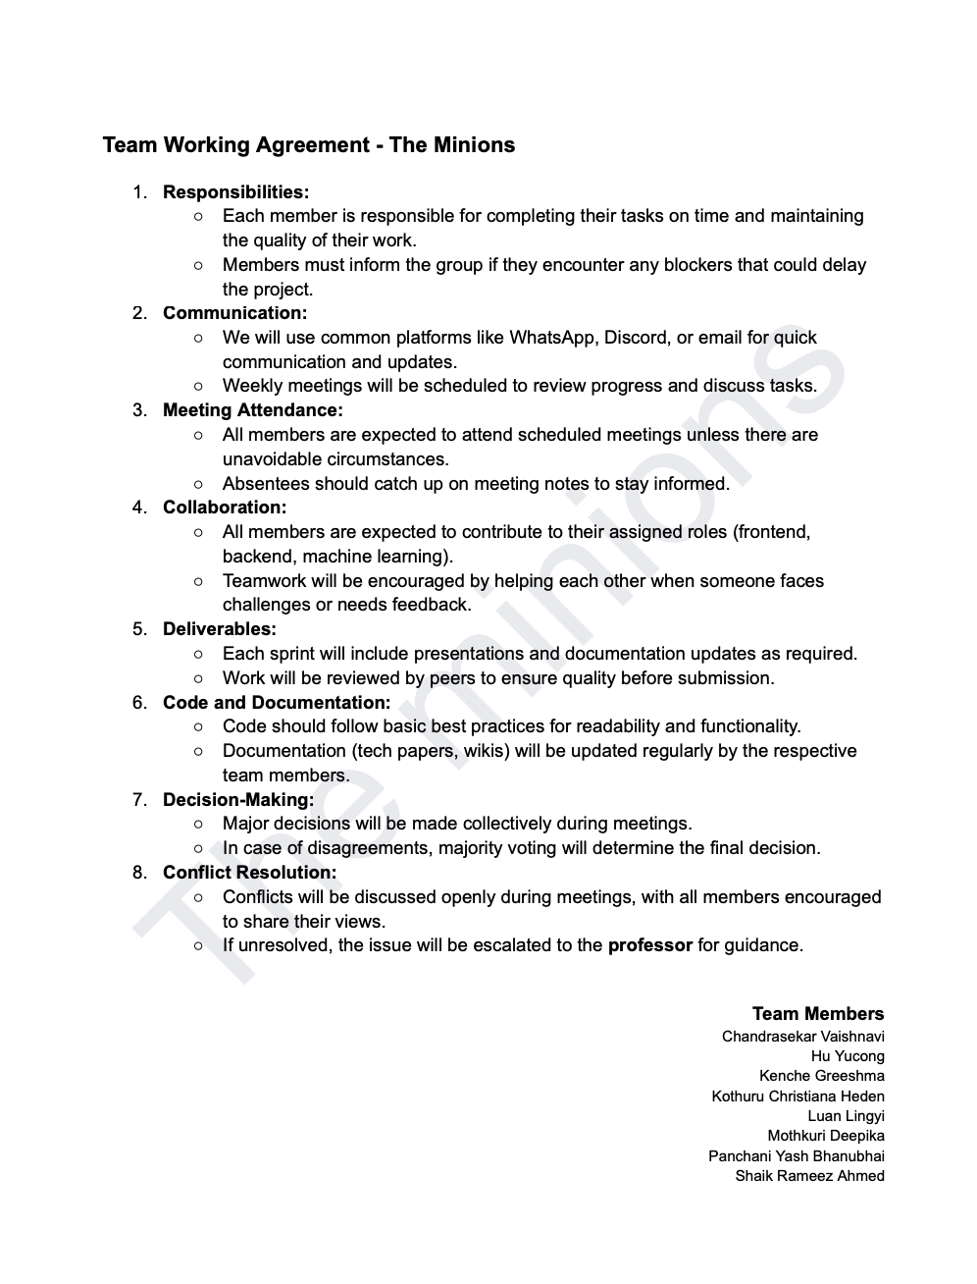
TEAM WORKING AGREEMENT

Slide 10
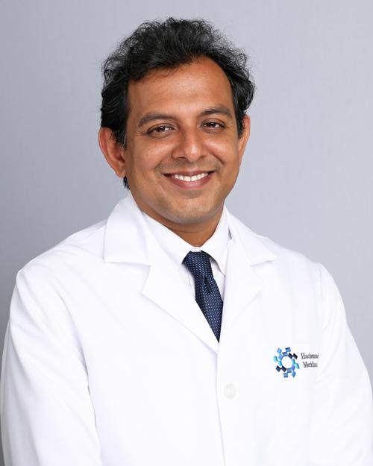
Personas
Dr. James Patel (Radiologist)
Age: 45
Occupation: Senior Radiologist at a metropolitan hospital
Background: Over 20 years of experience in diagnostic imaging, specializing in lung and brain disorders. Known for mentoring junior doctors in radiology.
Goals: To reduce the time spent analyzing large volumes of medical images while maintaining high diagnostic accuracy.
Challenges: Overloaded with image analysis requests and administrative duties, leading to delays in diagnosis and increased stress.
How the System Helps: Automates initial image classification and diagnosis, allowing Dr. Patel to prioritize critical and complex cases efficiently.

Slide 11
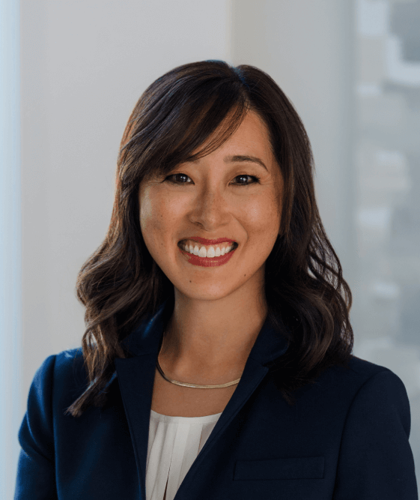
Personas
Dr. Suzen Chen (General Practitioner)
Age: 38
Occupation: General Practitioner at a rural healthcare clinic
Background: Has served in underserved regions for over a decade, often working without the immediate support of medical specialists. Committed to improving healthcare access in remote areas.
Goals: To provide fast, accurate diagnoses for patients despite limited access to specialists.
Challenges: She m ust handle a wide variety of cases on her own, making it difficult to diagnose complex conditions such as brain tumors and pneumonia accurately.
How the System Helps: The AI system offers reliable preliminary diagnoses for brain and lung conditions, helping Dr. Chen make timely and informed treatment decisions.

Slide 12

Personas
Dr. Raj Aryan (Healthcare Director)
Age: 50
Occupation: Director of a large hospital chain in India
Background: A visionary healthcare leader who has overseen the expansion of multiple hospitals across the country. Inspired by challenges faced in rural and semi-urban healthcare delivery.
Goals: To improve diagnostic efficiency, reduce patient wait times, and implement AI-based healthcare solutions across all branches.
Challenges: Delays in diagnosis caused by a shortage of skilled radiologists, leading to overcrowded hospitals and slow patient care.
How the System Helps: The automated system accelerates diagnosis processes across multiple hospitals, enabling faster and more efficient patient care, particularly in resource-constrained facilities.

Slide 13
MVP
Core Features
Two-Step Image Analysis
Classifies medical images as either lung X-rays or brain MRIs.
Provides automated diagnosis for pneumonia and brain tumors.
Automated Diagnosis System
Uses machine learning models to detect abnormalities.
Outputs a diagnostic result with confidence scores.
Unified Platform
Supports both lung X-rays and brain MRIs in a single system.
Eliminates the need for separate diagnostic tools.
User-Friendly Interface
Simple image upload functionality for healthcare professionals.
Displays classification results and diagnosis in an intuitive format.
Performance Metrics
Ensures accuracy through AI-driven predictions.
Optimized for faster diagnosis to reduce manual analysis time.
Basic Report Generation
Generates a preliminary diagnostic report.
Includes confidence levels and possible next steps for further medical review.

Slide 14






Technologies
Frontend: React.js
Used to create a user-friendly interface that allows healthcare professionals to upload and view medical images easily.
Backend: Node.js (API), Flask (Model Inference), MongoDB
Node.js: Handles API requests and manages communication between the frontend and backend services.
Flask: Supports model inference by running machine learning models for image classification and diagnosis.
MongoDB: Stores user data, images, and diagnostic results, enabling secure and scalable data management.
Machine Learning:
Built using PyTorch and trained on datasets for lung X-rays and brain MRIs.
Cloud Infrastructure:
Deployed using AWS.

Slide 15
Algorithms
The system uses two core algorithms based on pre-trained deep learning models. A ResNet model, fine-tuned on a dataset of medical images, is used to classify whether the uploaded image is a lung X-ray or a brain MRI. Depending on the classification result, the system proceeds to a second stage. For lung X-rays, a fine-tuned EfficientNet model detects and classifies pneumonia into normal, viral, or bacterial categories by analyzing lung patterns. For brain MRIs, the same EfficientNet model is used to detect and classify brain tumors into glioma, meningioma, or no tumor by identifying abnormalities in brain structures. These models provide high accuracy and efficiency, ensuring reliable diagnoses for both image types.

Slide 16
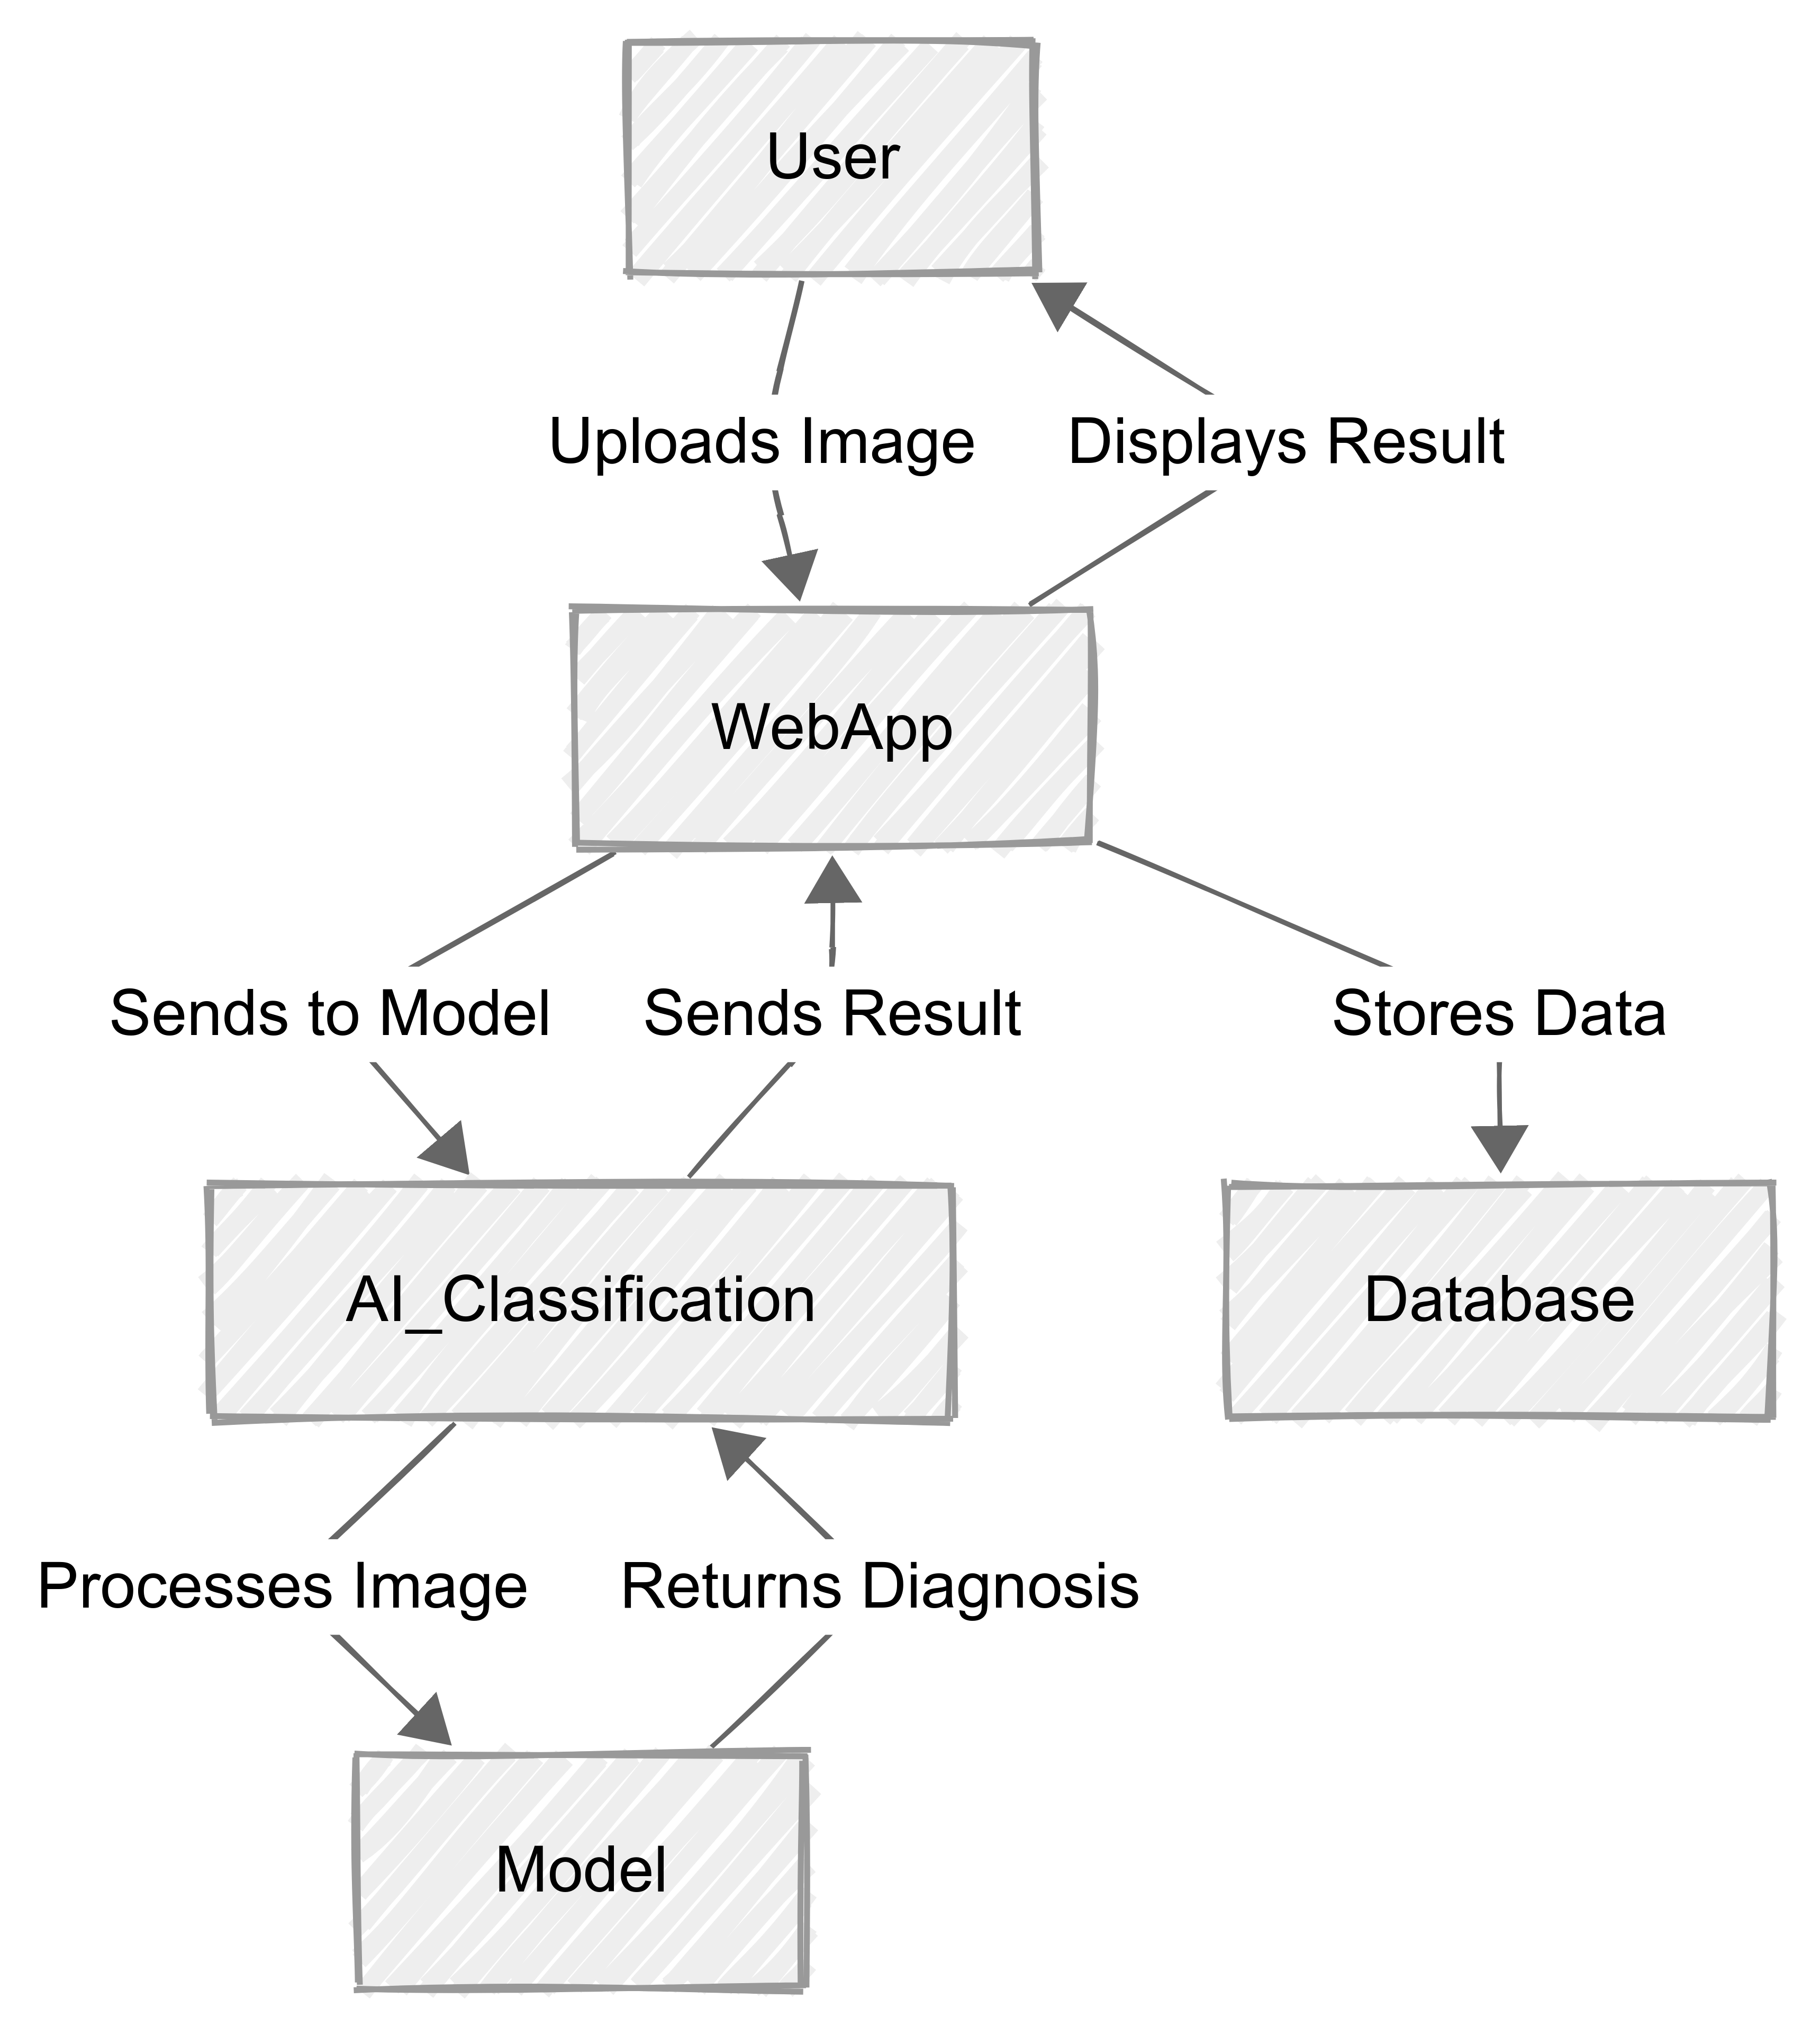
Architecture Diagram

Slide 17
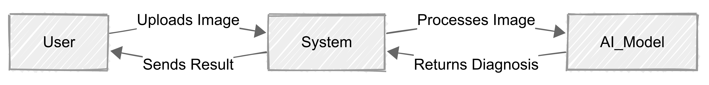
Context diagram

Slide 18
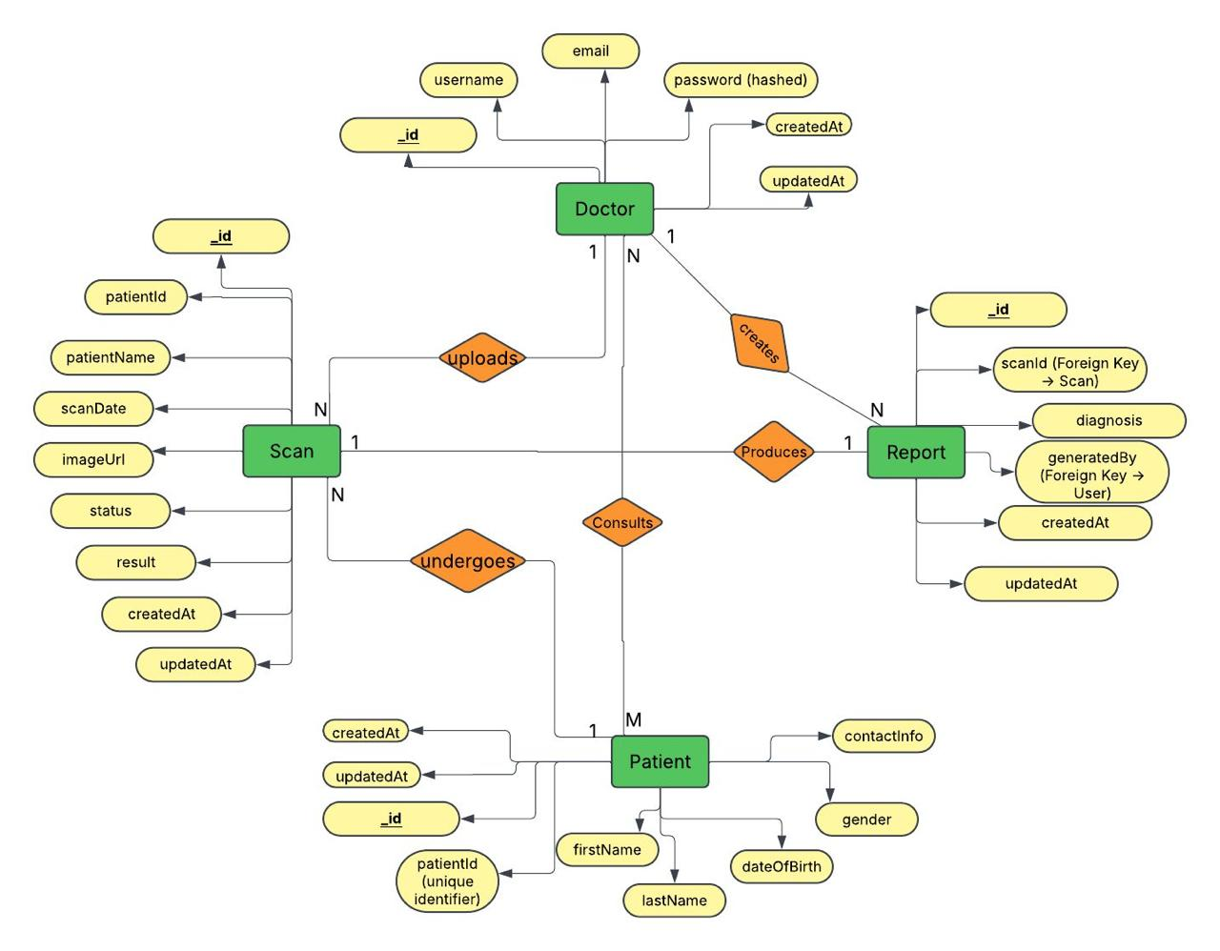
ER Diagram

Slide 19
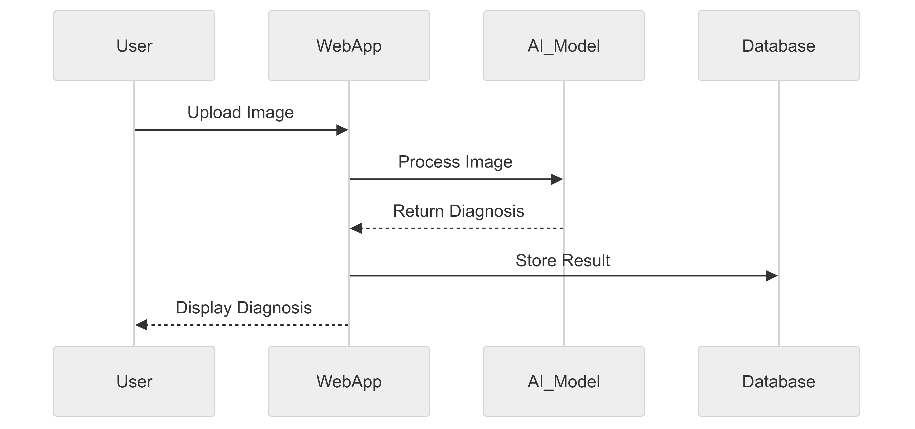
SEQUENCE DIAGRAM

Slide 20
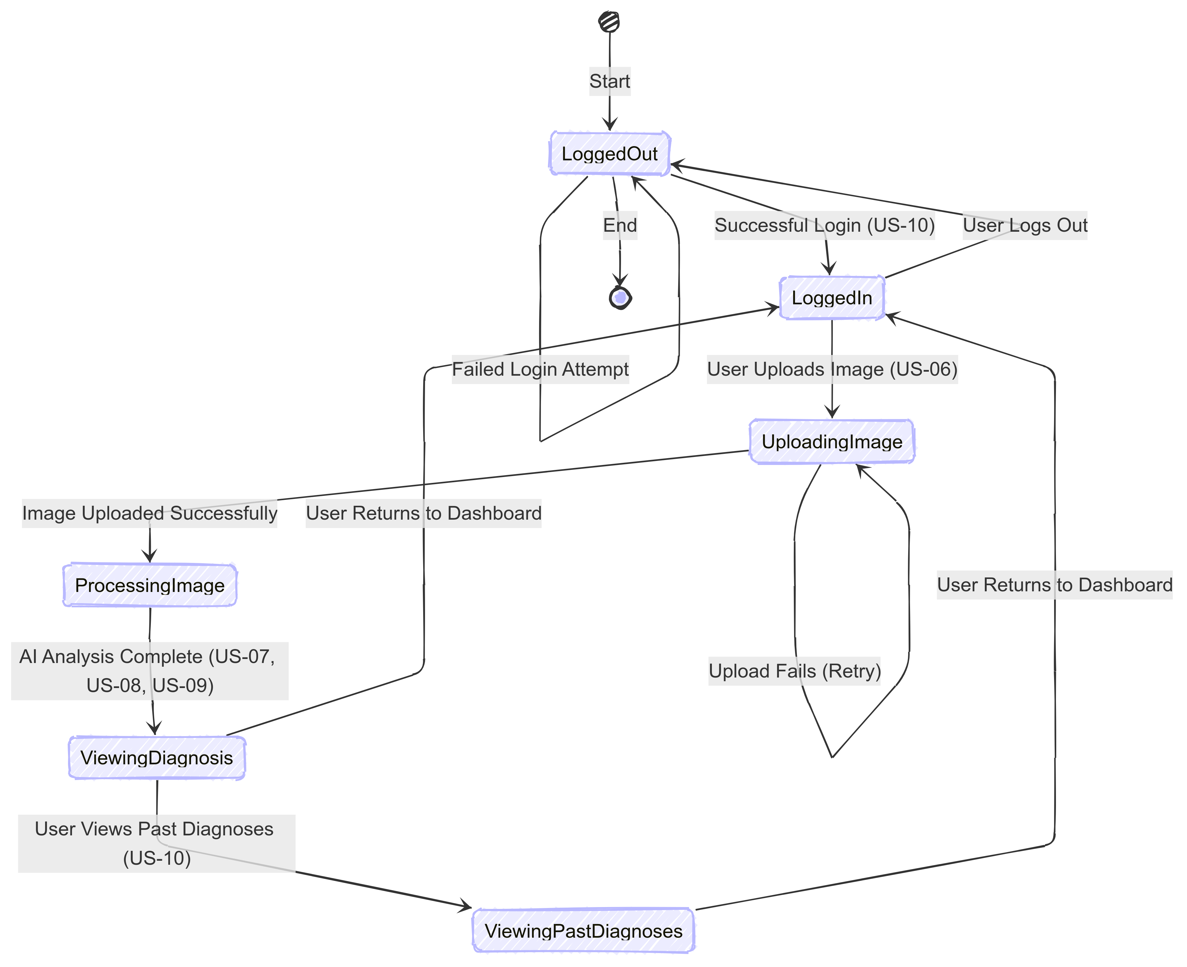
State diagram

Slide 21
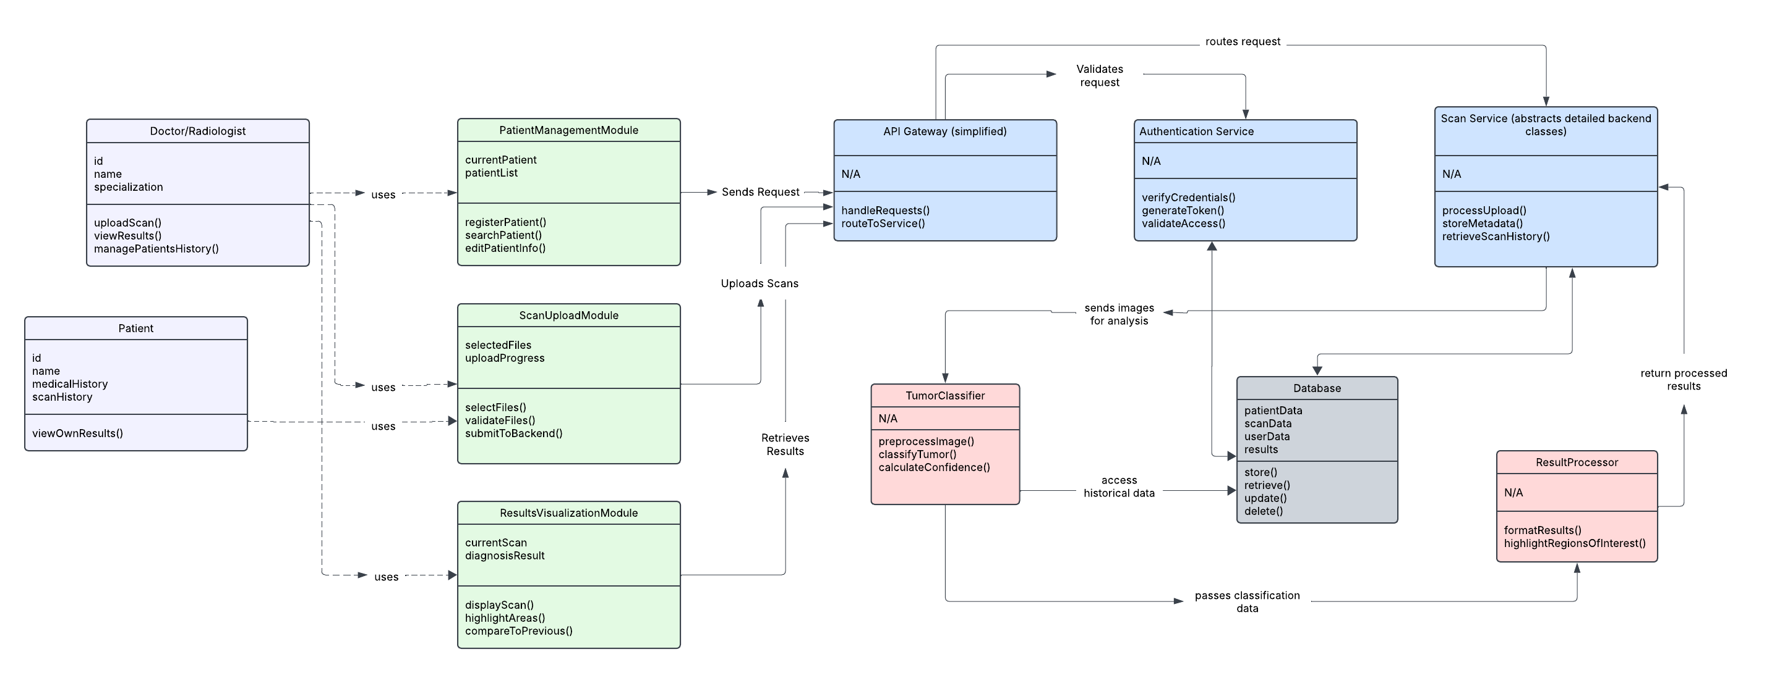
CLASS DIAGRAM

Slide 22
Sprint 2 recap
In Sprint 2, we implemented image upload, automatic AI diagnosis, and results storage features. User authentication and backend API integration were completed. Carried-over stories from Sprint 1, like static UI and simple upload, were finalized. Sprint 2 successfully delivered critical system functionality, moving closer to a fully operational platform.

Slide 23
Product Backlog
ID | Sprint | User Story / Technical Story (TS) | Acceptance Criteria | Story Points (SP)
US-01 | Sprint 1 | As a visitor, I want a landing page so I can understand the system at a glance. | - Page includes: header, project description, call-to-action button, and demo preview section. - Styling is consistent and visually engaging. - Page renders correctly on desktop and mobile browsers. | 3
US-02 | Sprint 1 | As a doctor/patient, I want an intuitive navigation menu so I can easily access different sections of the website. | - Navbar includes working links to: Home, Upload, Results, and About. - Navbar is fixed and responsive on all devices. | 2
US-03 | Sprint 1 | As a patient, I want a simple image upload interface so I can easily upload my medical images. | - Upload button allows file selection. - Image preview shown after selection. - Frontend only; no backend submission required. | 3
US-04 | Sprint 1 | As a mobile user, I want a responsive design so I can access the site on mobile devices. | - All pages adjust layout for screen sizes (mobile, tablet, desktop). - No overlapping or broken UI components. | 2

Slide 24
Product Backlog
ID | Sprint | User Story / Technical Story (TS) | Acceptance Criteria | Story Points (SP)
US-05 | Sprint 1 | As a patient, I want to see a static results page so I understand how the diagnosis will be displayed. | - Results page includes placeholders for image, diagnosis summary, and doctor notes. - Static dummy data is displayed correctly. | 2
TS-01 | Sprint 1 | As a developer, I want to set up the frontend framework and project structure so that the development is scalable. | - React project is initialized. - Routing for all planned pages is configured. - Folder structure follows best practices. | 2
TS-02 | Sprint 1 | As a developer, I want to implement UI components for buttons, inputs, and cards. | - Reusable styled components (Button, Input, Card) are created. - Components are tested and documented. | 3
US-06 | Sprint 2 | As a doctor, I want to upload an image and get it processed so I can receive a diagnosis. | - User can select and upload images. - Image is stored in the backend database. - Upload confirmation shown. | 5

Slide 25
Product Backlog
ID | Sprint | User Story / Technical Story (TS) | Acceptance Criteria | Story Points (SP)
US-07 | Sprint 2 | As a doctor, I want my medical image to be analyzed automatically so I can receive a diagnosis. | - Uploaded image is sent to AI model. - Model returns a classification (e.g., Normal, Pneumonia, Tumor). - Backend handles processing. | 8
US-08 | Sprint 2 | As a patient, I want to see my diagnosis displayed clearly so I can understand the results. | - Diagnosis result is shown on a result page. - Diagnosis includes label and confidence score. - UI is readable and visually clean. | 3
US-09 | Sprint 2 | As a patient, I want my diagnosis results to be stored so I can access them later. | - Diagnosis results and images are saved in the database. - Patient ID is linked to diagnosis entries. | 5
US-10 | Sprint 2 | As a patient, I want basic account authentication so I can securely log in and access my past diagnoses. | - Users can register and log in. - Passwords are encrypted. - Auth token/session is implemented. - Authenticated users can access their data. | 5

Slide 26
Product Backlog
ID | Sprint | User Story / Technical Story (TS) | Acceptance Criteria | Story Points (SP)
TS-03 | Sprint 2 | As a developer, I want to set up a backend API for image processing so that the system can analyze uploaded images efficiently. | - Flask/Django API accepts image uploads. - Routes for upload and prediction exist. - Image is processed and response returned. | 8
TS-04 | Sprint 2 | As a developer, I want to connect the frontend with the backend API so that data flows seamlessly between the client and server. | - Frontend sends requests to backend API. - Data from API is shown on the frontend. - Error states are handled. | 5
US-11 | Sprint 3 | As a patient, I want my diagnosis report to be downloadable so I can share it with doctors. | - Diagnosis results can be exported as a downloadable PDF. - PDF includes patient info, image, diagnosis, and date. | 5
US-12 | Sprint 3 | As a patient, I want a faster processing time so I don’t have to wait long for results. | - AI model processes images in under 2 seconds. - Response time tested on at least 10 different inputs. | 8

Slide 27
Product Backlog
ID | Sprint | User Story / Technical Story (TS) | Acceptance Criteria | Story Points (SP)
US-13 | Sprint 3 | As a doctor, patient, or admin, I want role-based access (doctor, patient, admin) so I can have personalized features. | - Users have roles (doctor, patient, admin). - Role-based dashboards and permissions implemented. - Unauthorized access blocked. | 5
US-14 | Sprint 3 | As a patient, I want the system to be highly accurate so I can trust the diagnosis. | - AI model reaches ≥90% accuracy on validation set. - Accuracy is documented and verified through testing. | 8
US-15 | Sprint 3 | As a patient, I want to access my health data quickly so I can get the information I need without delays. | - The system delivers data with minimal load time. - Optimized backend queries and efficient frontend rendering. - Performance tested across common devices and networks. | 5
TS-05 | Sprint 3 | As a developer, I want to implement logging and error handling so that system failures can be monitored and resolved efficiently. | - System logs backend/frontend errors. - Admin receives error notifications or logs are stored for debugging. - Critical failures are caught and don't crash the app. | 3

Slide 28
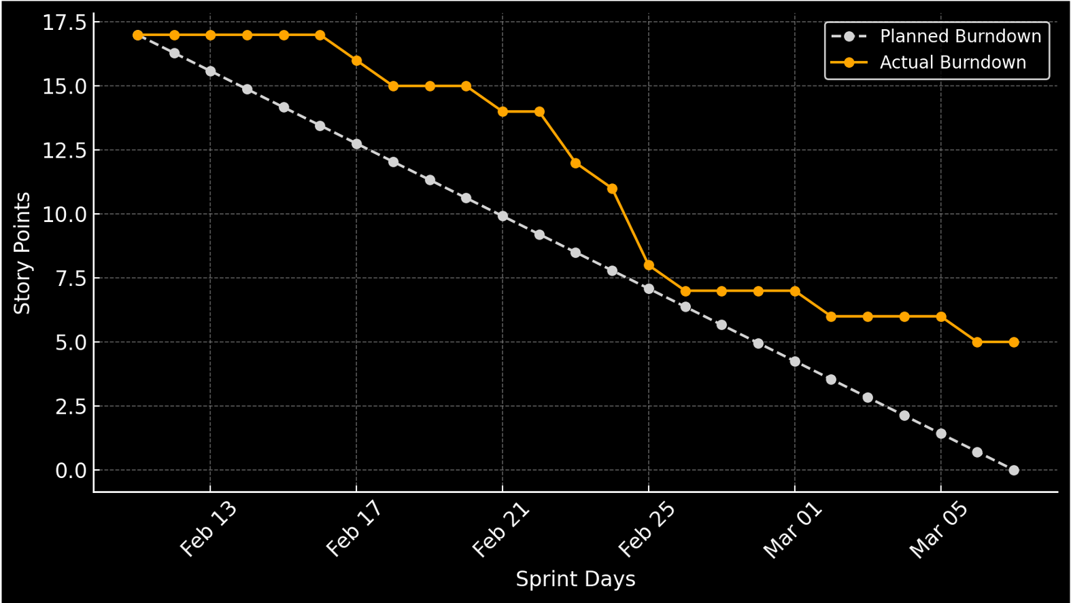
Sprint Summary
Sprint 1 Completed User Stories/Tasks:
US-01: As a visitor, I want a landing page so I can understand the system at a glance. (3 SP)
US-02: As a doctor/patient, I want an intuitive navigation menu to access different sections. (2 SP)
US-03: As a patient, I want a simple image upload interface. (3 SP)
US-04: As a mobile user, I want a responsive design. (2 SP)
US-05: As a patient, I want to see a static results page. (2 SP)
TS-01: As a developer, I want to set up the frontend framework. (2 SP)
TS-02: As a developer, I want to implement reusable UI components. (3 SP)

Slide 29
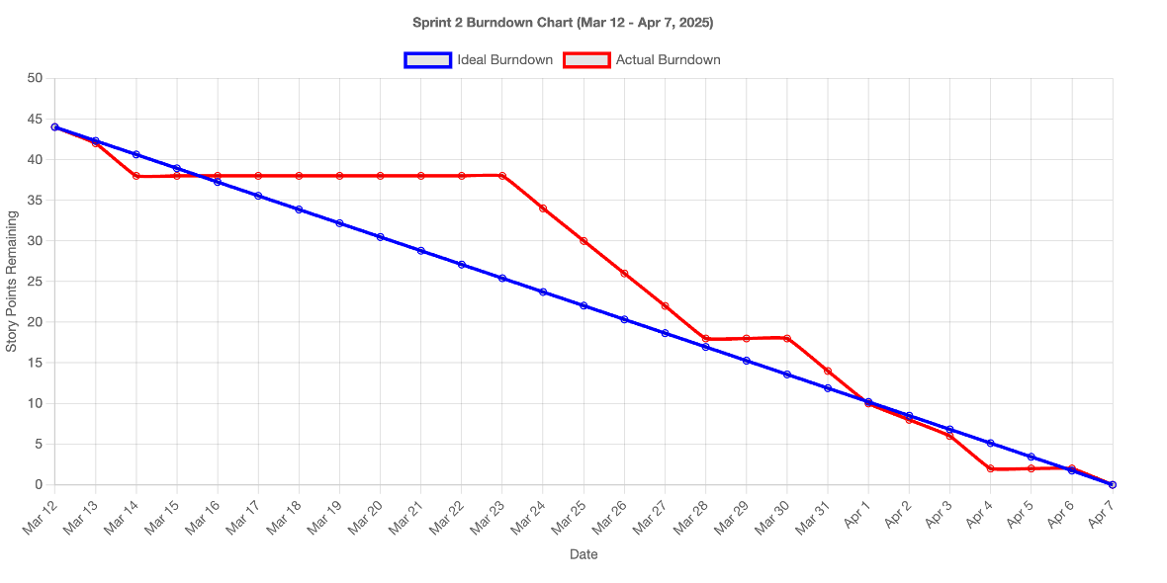
Sprint Summary
Sprint 2 Completed User Stories/Tasks:
US-06: As a doctor, I want to upload an image and get it processed. (5 SP)
US-07: As a doctor, I want my medical image analyzed automatically. (8 SP)
US-08: As a patient, I want to see my diagnosis displayed clearly. (3 SP)
US-09: As a patient, I want my diagnosis results stored for later access. (5 SP)
US-10: As an admin, I want basic account authentication. (5 SP)
TS-03: As a developer, I want to set up a backend API for image processing. (8 SP)
TS-04: As a developer, I want to connect the frontend with the backend API. (5 SP)

Slide 30
Sprint 3 BACKLOG
ID | Sprint | User Story / Technical Story (TS) | Acceptance Criteria | Story Points (SP)
US-11 | Sprint 3 | As a patient, I want my diagnosis report to be downloadable so I can share it with doctors. | - Diagnosis results can be exported as a downloadable PDF. - PDF includes patient info, image, diagnosis, and date. | 5
US-12 | Sprint 3 | As a researcher, I want a faster processing time so I don’t have to wait long for results. | - AI model processes images in under 2 seconds. - Response time tested on at least 10 different inputs. | 8
US-13 | Sprint 3 | As a system admin, I want role-based access (doctor, patient, admin) so I can have personalized features. | - Users have roles (doctor, patient, admin). - Role-based dashboards and permissions implemented. - Unauthorized access blocked. | 5
US-14 | Sprint 3 | As a doctor, I want the system to be highly accurate so I can trust the diagnosis. | - AI model reaches ≥90% accuracy on validation set. - Accuracy is documented and verified through testing. | 8
US-15 | Sprint 3 | As a patient, I want to access my health data quickly so I can get the information I need without delays | - The system delivers data with minimal load time. - Optimized backend queries and efficient frontend rendering. - Performance tested across common devices and networks. | 5
TS-05 | Sprint 3 | As a developer, I want to implement logging and error handling so that system failures can be monitored and resolved efficiently. | - System logs backend/frontend errors. - Admin receives error notifications or logs are stored for debugging. - Critical failures are caught and don't crash the app. | 3

Slide 31
Sprint 3 test cases
ID | Test Case Description | Expected Result | Actual Result | Pass/Fail
US-11-TC01 | Verify that diagnosis reports can be downloaded as a PDF. | PDF download prompt appears; file contains patient info, diagnosis image, diagnosis results, and date. | Diagnosis PDF downloads successfully with all required information. | Pass
US-12-TC01 | Measure image processing time across multiple inputs. | Images processed in under 2 seconds for at least 10 different test inputs. | All images processed under 2 seconds during testing. | Pass
US-13-TC01 | Verify that users have assigned roles (doctor, patient, admin) upon login or registration. | Role is correctly assigned and stored in the system. | User roles assigned correctly upon registration and login. | Pass
US-13-TC02 | Verify role-based dashboard visibility. | Doctor sees doctor dashboard, patient sees patient dashboard, admin sees admin dashboard. | Appropriate dashboards displayed based on user role. | Pass
US-13-TC03 | Attempt unauthorized access (e.g., patient tries to access admin features). | Access is denied with proper error/message. | Unauthorized access attempts were blocked with proper error messages. | Pass
US-14-TC01 | Validate AI model accuracy on validation set. | Accuracy ≥90% achieved, documented, and verified. | Model achieved 91% accuracy during validation testing. | Pass

Slide 32
Sprint 3 test cases
ID | Test Case Description | Expected Result | Actual Result | Pass/Fail
TS-05-TC01 | Trigger a backend error and check if it is logged properly. | Error is recorded in the system logs without crashing the app. | Backend errors logged successfully without system crash. | Pass
TS-05-TC02 | Trigger a frontend error and ensure it is logged appropriately. | Frontend error captured and stored/logged without application crash. | Frontend errors captured and logged correctly. | Pass
TS-05-TC03 | Simulate a critical failure and verify system stability and notification/logging behavior. | Critical error is caught gracefully; admin notified, or issue stored for debugging without crashing the entire system. | Critical failures handled smoothly and logged for admin review. | Pass

Slide 33
Sprint 3 Stories completed
ID | User Story / Task (TS) | Story Points (SP)
US-11 | As a patient, I want my diagnosis report to be downloadable so I can share it with doctors. | 5
US-12 | As a researcher, I want a faster processing time so I don’t have to wait long for results. | 8
US-13 | As a system admin, I want role-based access (doctor, patient, admin) so I can have personalized features. | 5
US-14 | As a doctor, I want the system to be highly accurate so I can trust the diagnosis. | 8
US-15 | As a patient, I want to access my health data quickly so I can get the information I need without delays | 5
TS-05 | As a developer, I want to implement logging and error handling so that system failures can be monitored. | 3
Total Story Points: 34

Slide 34
Metrics
Team Velocity Total Story Points Completed: 34 SP Team Velocity: 34 SP
Completed/Committed Ratio Total Story Points Committed: 34 SP Total Story Points Completed: 34 SP Completed/Committed Ratio: (34/34) = 100%
Average Completed/Committed Ratio: Sprint 1: 70.59%
Sprint 2: 100%
Sprint 3: 100%
Average = (70.59 + 100 + 100) / 3 = 90.20%

Slide 35
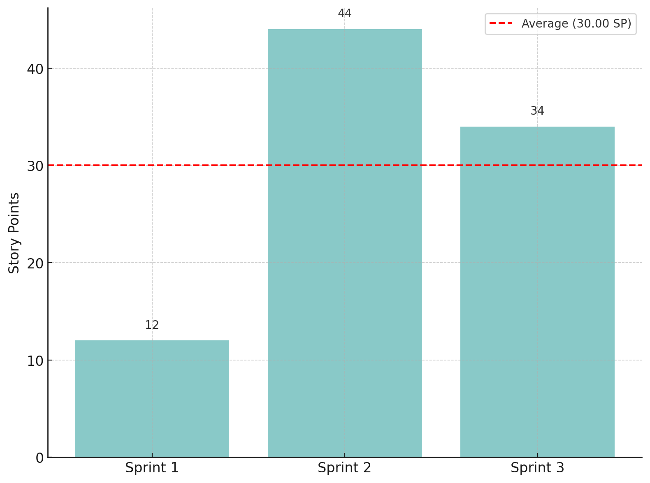
HISTORICAL TEAM VELOCITY

Slide 36
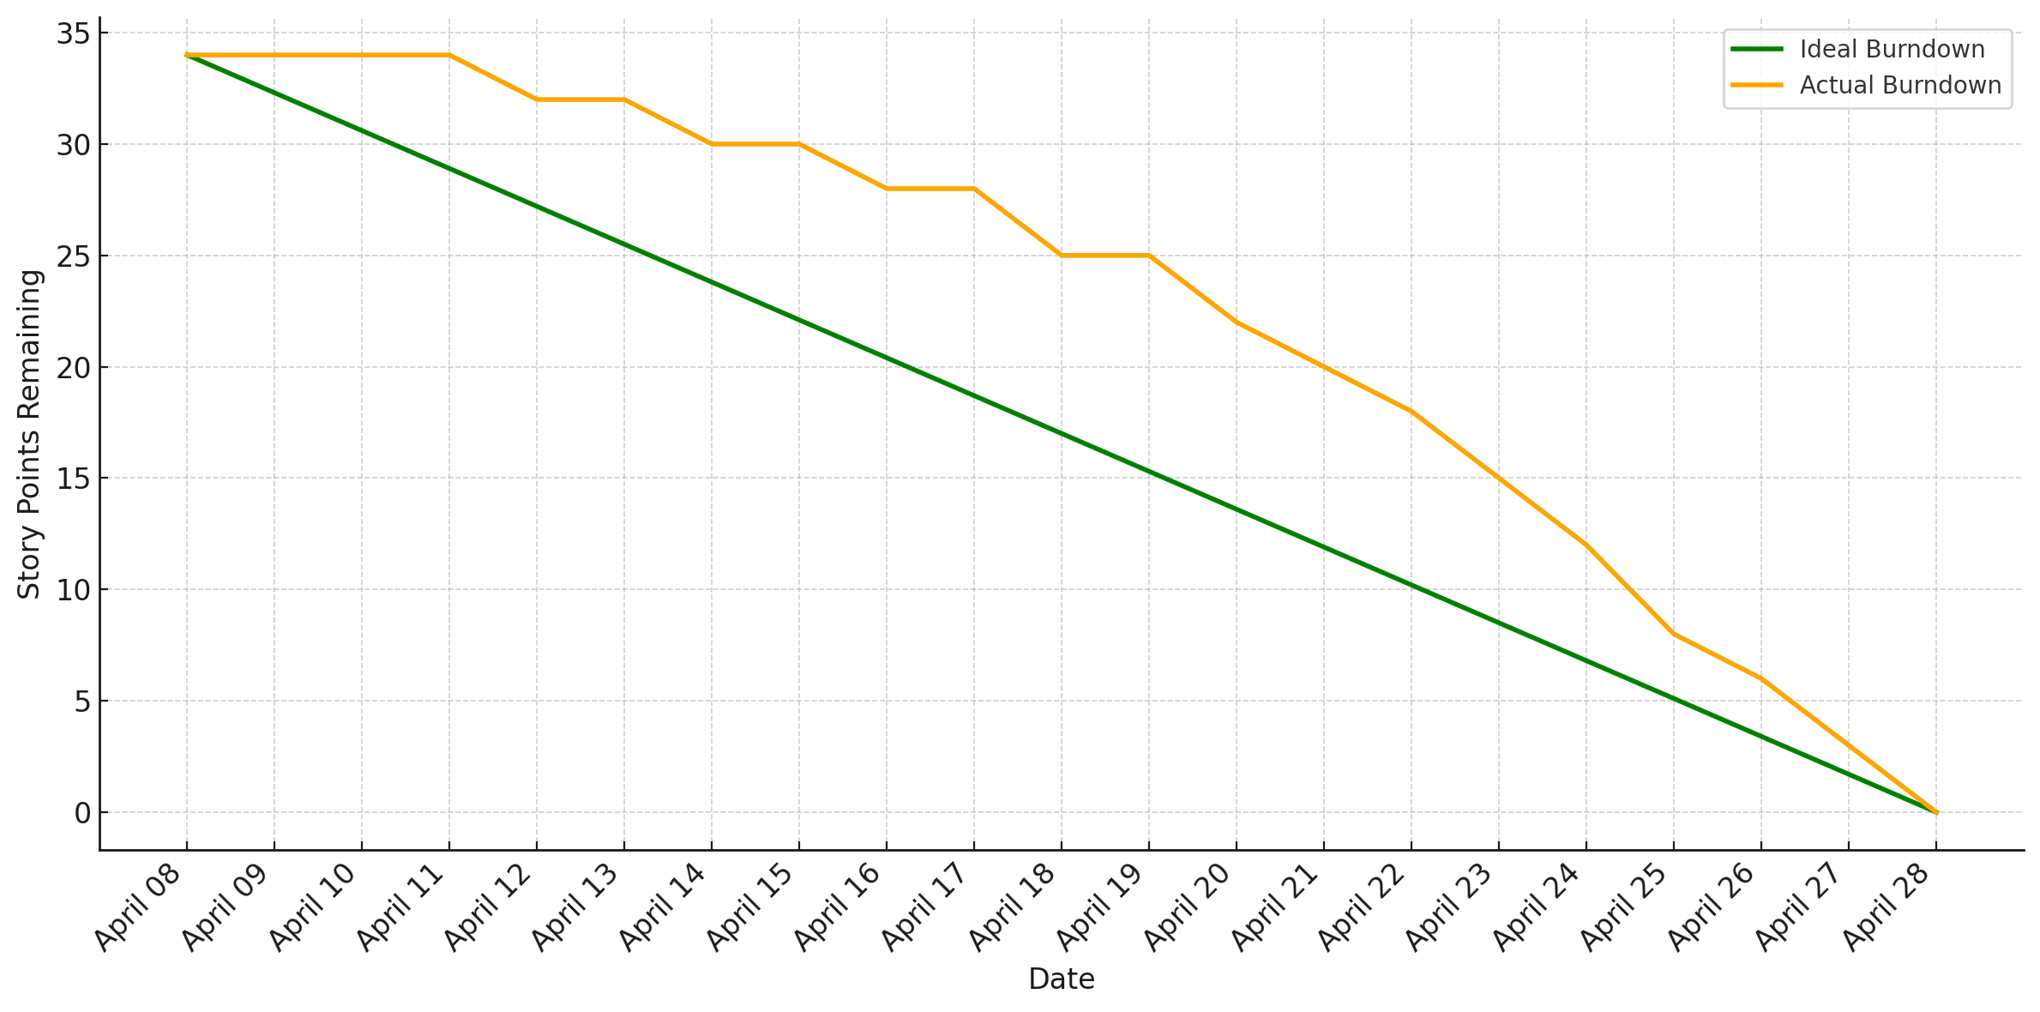
BURNDOWN CHART

Slide 37
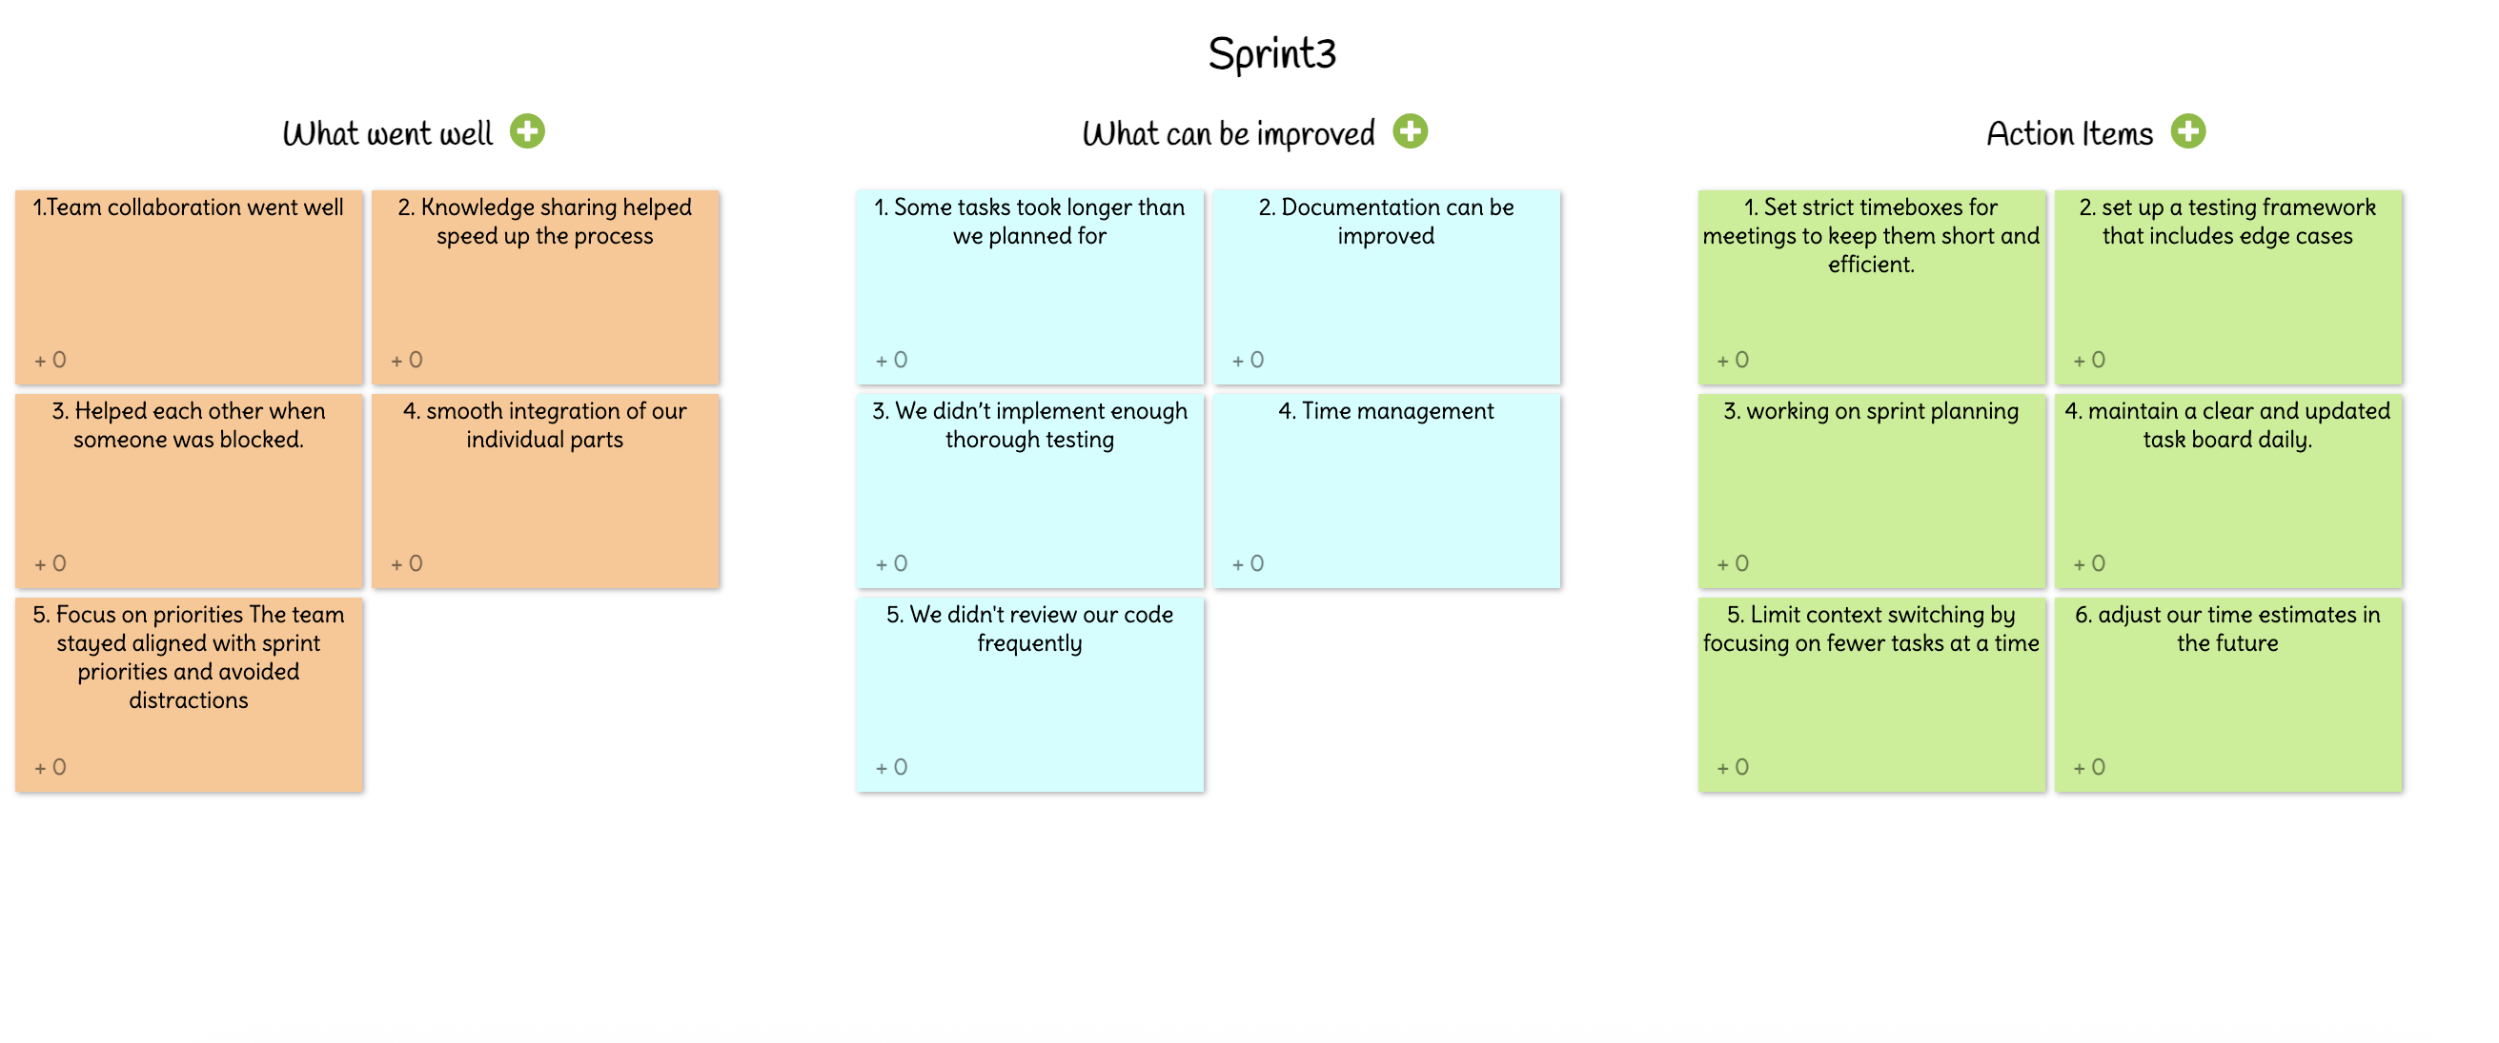
rETROSPECTIVE

Slide 38
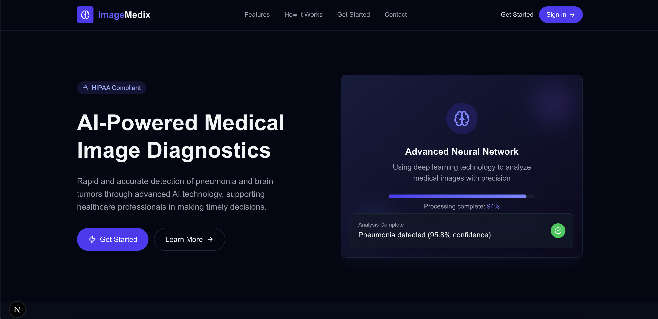
Application SCreenshots

Slide 39
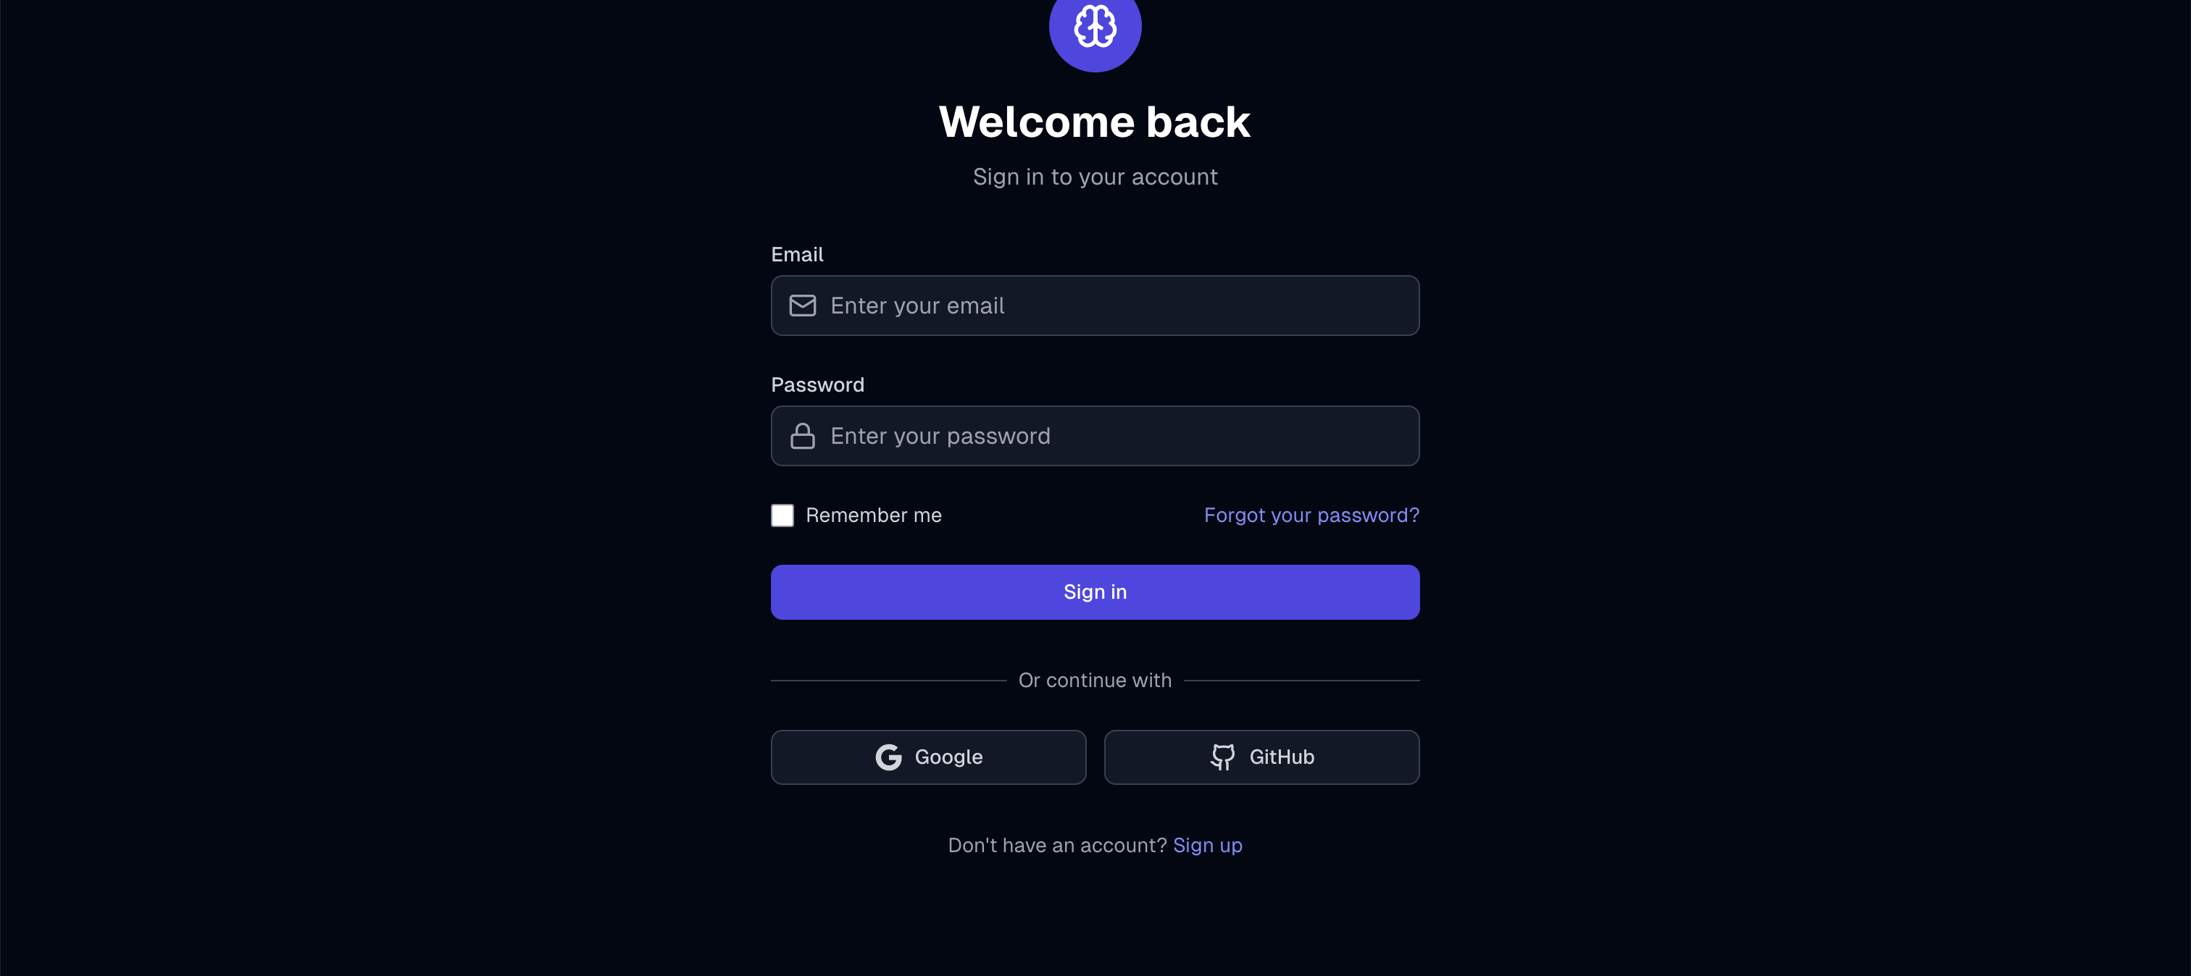

Slide 40
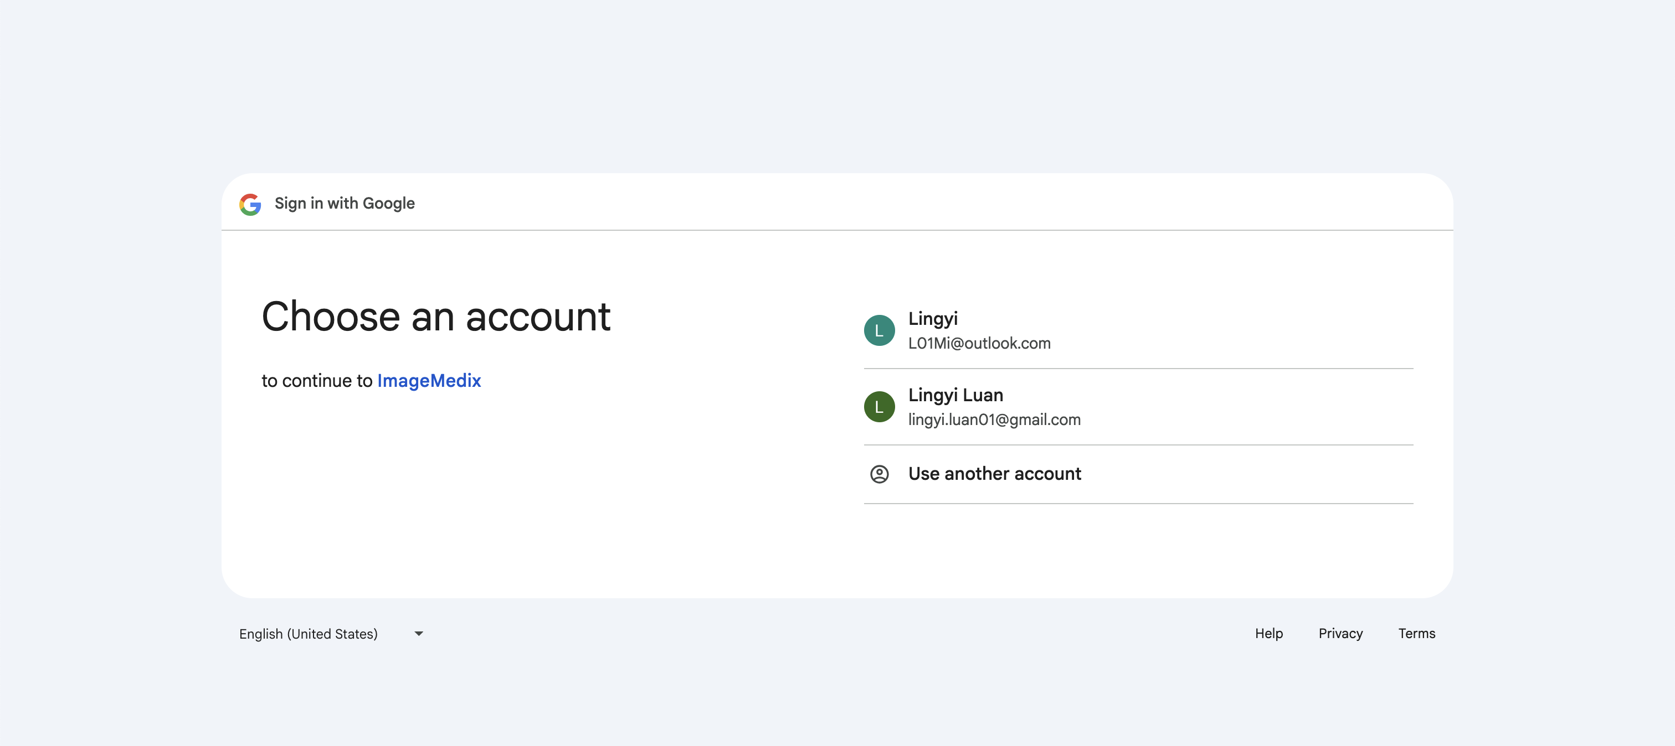

Slide 41
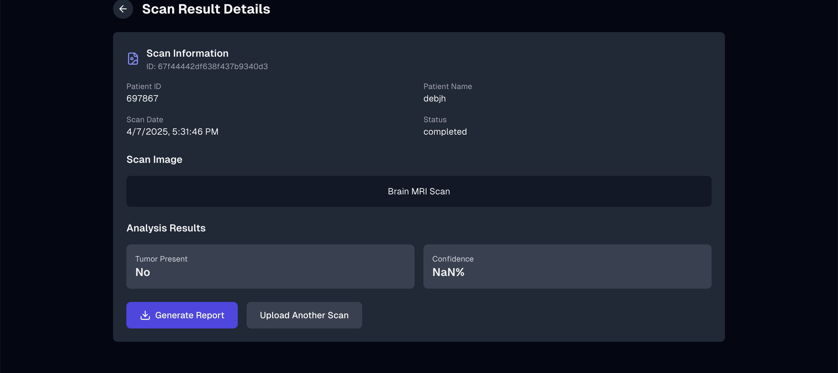

Slide 42
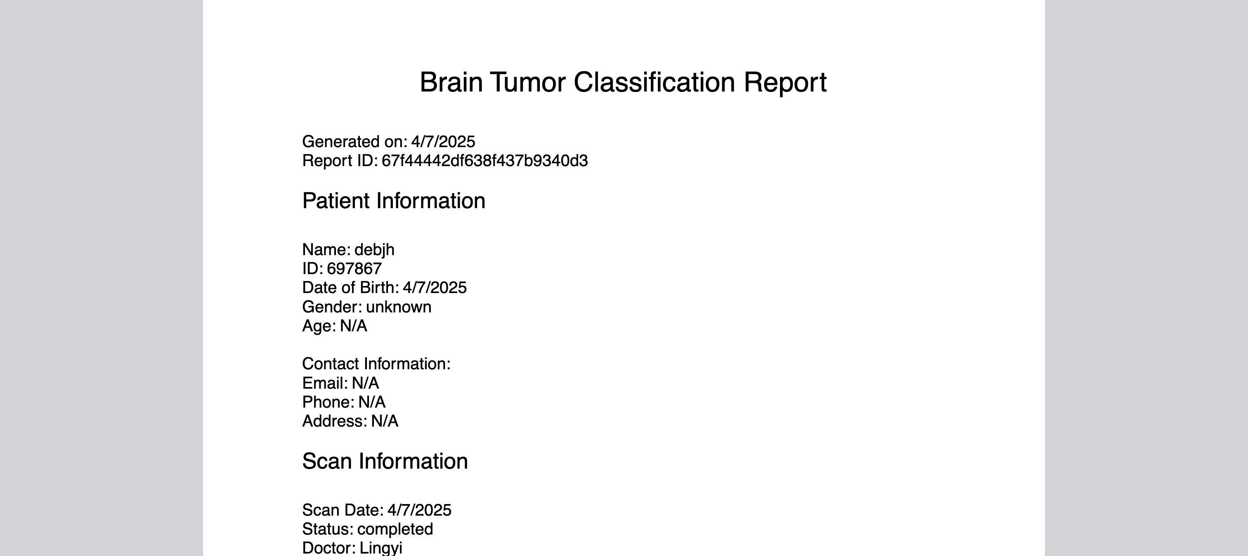

Slide 43
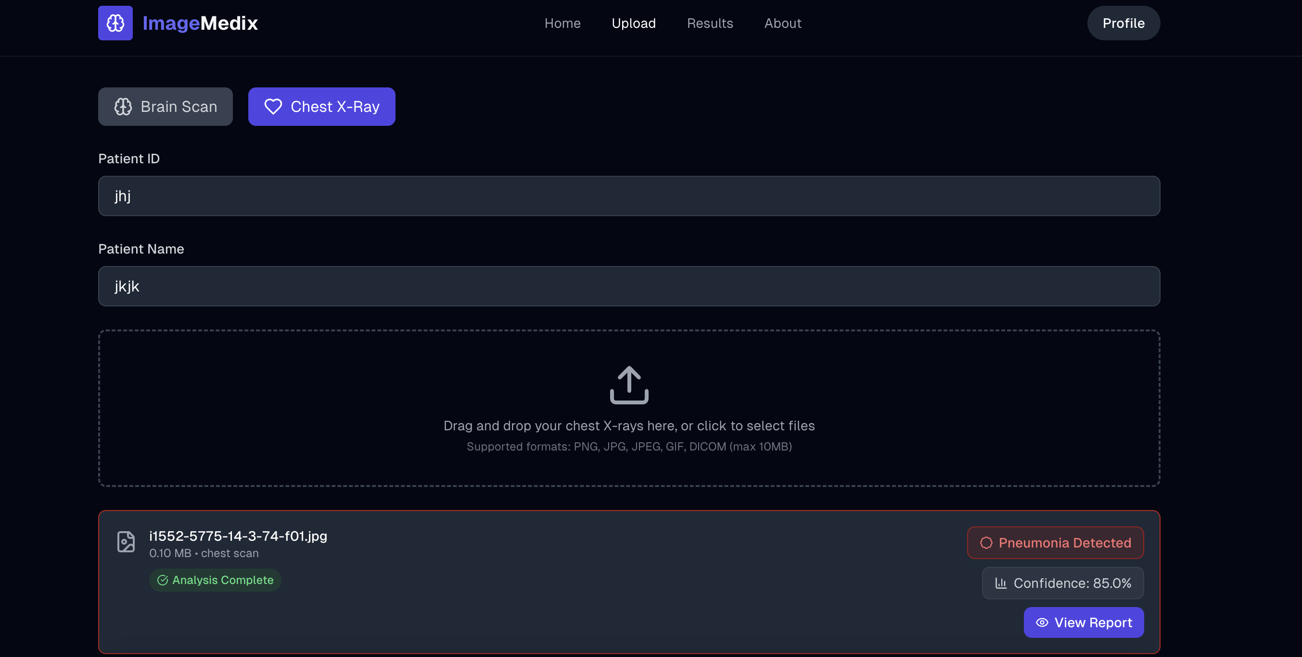

Slide 44
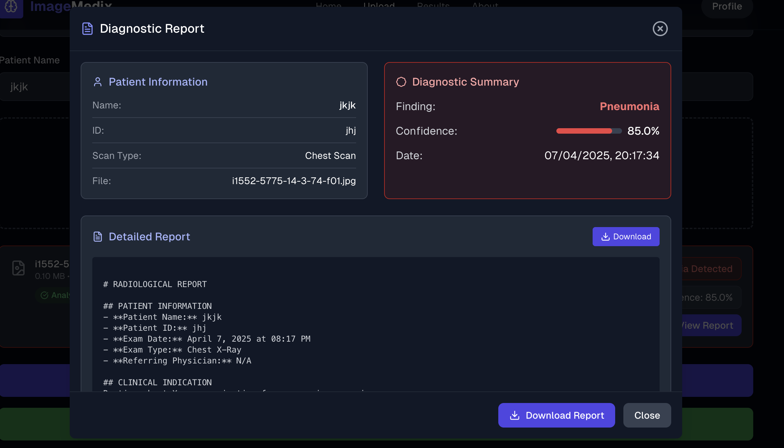

Slide 45
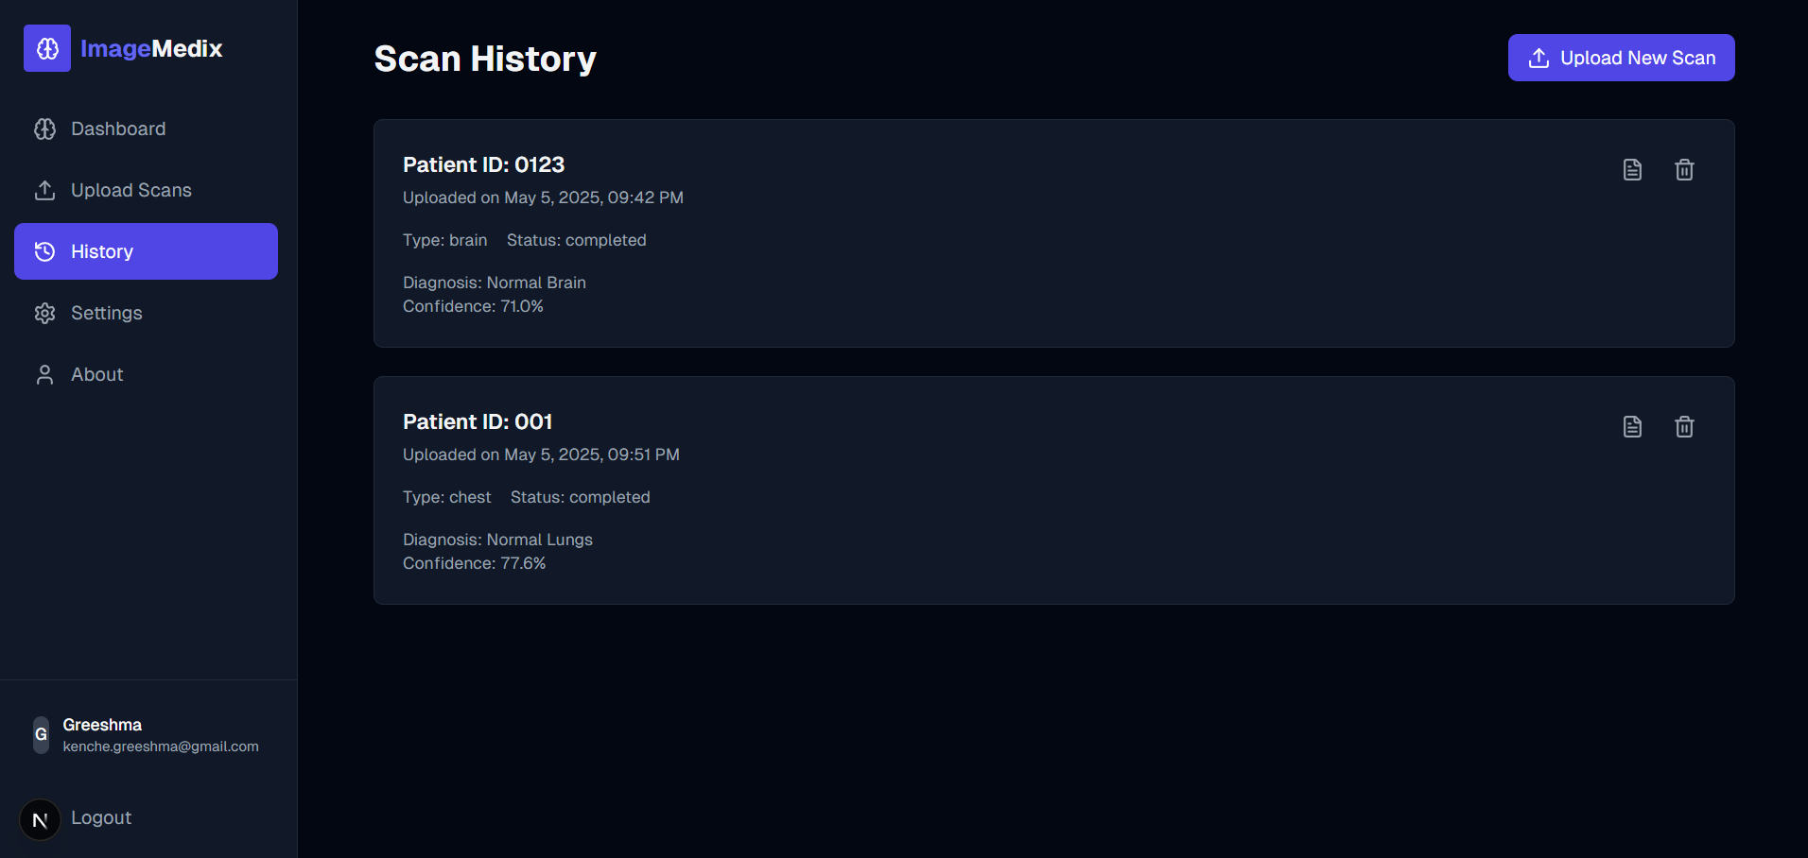

Slide 46
Key API Endpoints
Authentication APIs:
Copy
GET /api/auth/google | -Google OAuth login
POST /api/auth/login | -Email/password login
GET /api/auth/me | -Get current user
POST /api/auth/register | -Register new user

Slide 47
Key API Endpoints
Scan Management APIs:
GET /api/scans | - Get all scans
POST /api/scans | - Upload new scan
GET /api/scans/:id | - Get scan by ID
GET /api/scans/:id/status | - Check analysis status
POST /api/scans/:id/report | - Generate PDF report

Slide 48
Key API Endpoints
ML Model APIs:
POST /api/brain/analyze | - Analyze brain MRI scan

Slide 49
Wikipage linK
https://github.com/htmw/2025S-The-Minions/wiki

Slide 50
Application Demo

Slide 51
tHANK YOU

